Slide 1


PSI: Professional Issues Essay
Writing for College of Science and Engineering Students
Dr James Rowe
james.rowe@glasgow.ac.uk

Slide 2
Today
We will look at:
Understanding essay questions
Structure
Argumentation
Writing quality/tone/style
You can get most of the way there by following procedures

Slide 3
Stages of writing an essay
Understand/refine the question
Background research
Formulate your argument
Plan structure
Write
Proofread

Slide 4
Writing Topics (1)
Understanding Essay Questions
Structure
Argumentation
Writing quality/tone/style

Slide 5
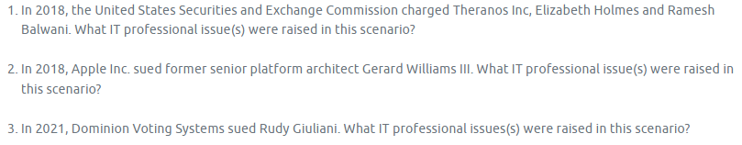
Comparing essay topics
What are the commonalities between these questions?
Looking at the commonalities, what information do you think you’re supposed to deliver?
What do you think the target of this essay is?

Slide 6
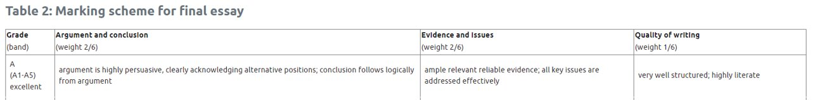
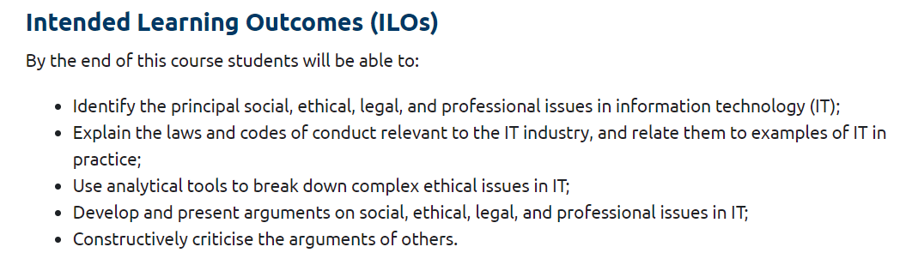
Learning about expectations elsewhere…

Slide 7
Expectations for Professional Issues essay
Your essay should inform on a CS/SE issue in a way that’s understandable to your classmates
It should take a stance. You should develop and demonstrate your own professional/academic opinion
You should demonstrate your communication and critical thinking skills
Structure
Argumentation
Writing quality

Slide 8
Writing Topics (2)
Understanding Essay Questions
Structure
Argumentation
Writing quality/tone/style

Slide 9
How should an essay be structured?
Intro (10%), main body (80%), conclusions (10%)
For an essay of a few thousand words where specific questions are given – no research statement, abstract etc
(Check for subject/course-specific requirements)

Slide 10
Introduction
Start broad (context), move towards specificity
Why is this specific issue/case worth discussing?
What are you going to address, and why?

Slide 11
Main body
Consider grouping your findings by key themes
Order them so that they lead naturally through the text (presume “educated peer” level knowledge)
Think about what background knowledge your reader has and lead them through the content logically

Slide 12
An example of structure – James (1)
Here is an example from my thesis:
Introduction
Preliminaries
Theory
Application 1
Application 2

Slide 13
An example of structure – James (2)
Introduction: TT-Geometry is powerful and interesting
Preliminaries: All of the algebra and category theory we need
Theory: All of the theoretical results, completely abstracted
Application 1: Apply all of the theory to a particular example
Application 2: Apply all of the theory to a particular example

Slide 14
An alternative structure – James (1)
I could have structured it differently!
Introduction
Preliminaries
Introduce examples
A little bit of theory
Application to both examples
Repeat from step 4

Slide 15
An alternative structure – James (2)
Introduction: TT-Geometry is powerful and interesting
Preliminaries: All of the algebra and category theory we will need
Introduce examples: We care about derived categories and lattices
A little bit of theory: Prove one little result
Application to both examples: Apply the result to both examples
Repeat from step 4

Slide 16
Conclusion
Summarise the main ideas
Provide an answer to the question. Take a stance.
(Possible future directions…)
No introducing new material in the conclusion

Slide 17
Writing Topics (3)
Understanding Essay Questions
Structure
Argumentation
Writing quality/tone/style

Slide 18
Argumentation
You need to present complex legal and moral issues
Clearly
Taking a stance
You can say anything you want in academic writing – provided you can support it
Typically this means using papers
What else might it mean in this context?
When using other types of media – credibility?

Slide 19
Voicing your academic opinion (1)
What we often see:
The authors claim to have shed light on the development of language in children, however the research is flawed because the balance of male to female participants included in the study was not equal.
This doesn’t fully convey your understanding of the issue.
Why does the identified strength/flaw matter to research quality?

Slide 20
Voicing your academic opinion (2)
The authors claim to have shed light on the development of language in children; however, the research is flawed because the balance of male to female participants included in the study was not equal. The study included 34 male and 4 female participants. In addition to the sample not being representative of the population it is applied to, previous research has established that there are sex-based differences in the rate of social development in children (French, 2019). So, while the findings of the authors may apply to language development in male children, the same conclusions cannot be applied to female children.

Slide 21
Structuring an argument
Statement
Evidence
Deduction/conclusion
Extrapolation

Slide 22
Voicing your academic opinion (3)
The authors claim to have shed light on the development of language in children; however, the research is flawed because the balance of male to female participants included in the study was not equal. The study included 34 male and 4 female participants. In addition to the sample not being representative of the population it is applied to, previous research has established that there are sex-based differences in the rate of social development in children (French, 2019). So, while the findings of the authors may apply to language development in male children, the same conclusions cannot be applied to female children.

Slide 23
Voicing your academic opinion (4)
The authors claim to have shed light on the development of language in children; however, the research is flawed because the balance of male to female participants included in the study was not equal. The study included 34 male and 4 female participants. In addition to the sample not being representative of the population it is applied to, previous research has established that there are sex-based differences in the rate of social development in children (French, 2019). So, while the findings of the authors may apply to language development in male children, the same conclusions cannot be applied to female children.

Slide 24
Voicing your academic opinion (5)
The authors claim to have shed light on the development of language in children; however, the research is flawed because the balance of male to female participants included in the study was not equal. The study included 34 male and 4 female participants. In addition to the sample not being representative of the population it is applied to, previous research has established that there are sex-based differences in the rate of social development in children (French, 2019). So, while the findings of the authors may apply to language development in male children, the same conclusions cannot be applied to female children.

Slide 25
Voicing your academic opinion (6)
The authors claim to have shed light on the development of language in children; however, the research is flawed because the balance of male to female participants included in the study was not equal. The study included 34 male and 4 female participants. In addition to the sample not being representative of the population it is applied to, previous research has established that there are sex-based differences in the rate of social development in children (French, 2019). So, while the findings of the authors may apply to language development in male children, the same conclusions cannot be applied to female children.

Slide 26
Writing Topics (4)
Understanding Essay Questions
Structure
Argumentation
Writing quality/tone/style

Slide 27
Academic writing should be
Clear
Concise
Unbiased
Focused
Accurate
Appropriately cautious

Slide 28
Clear
Complex concepts – simple articulation
Check that your reader doesn’t have to look elsewhere in your writing (or at another source)
Logical ordering
“Educated peer” assumption
Check that your reader doesn’t have to make assumptions about what you mean to say.

Slide 29
Concise
Get to the point quickly
Omit needless words
Never use a long word where a short one will do

Slide 30
Unbiased
Convince people using facts and data, not using persuasive language
Use appropriate hedging language when talking about how convinced you are by the evidence
Don’t push data/findings to fit your stance/hypothesis

Slide 31
Focused
Science writing should have a clear purpose that is indicated at the outset.
Make sure YOU are clear about this
What is the answer to the question?
What are your (3-6) key points?
Re-read your work. For every sentence, ask yourself “what does this contribute to my answer to the question?”

Slide 32
Accurate (1)
What’s the difference between “accurate” and “precise”?

Slide 33
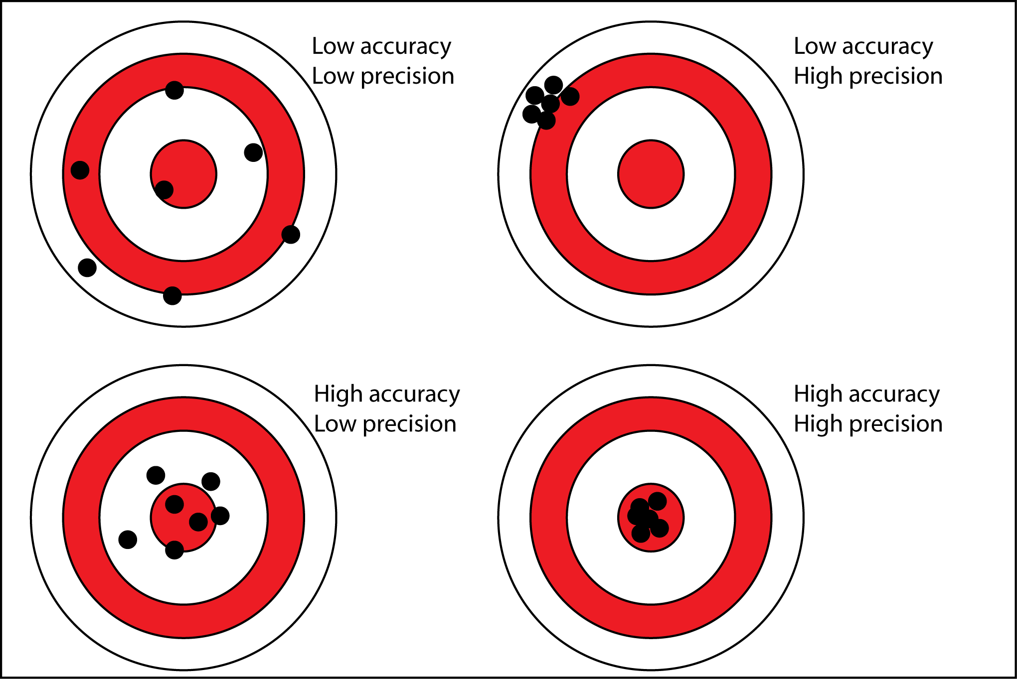
Accurate (2)
Clarity in understanding
Clarity in language
Difficult to have #2 without #1

Slide 34
Appropriately cautious
It’s rare to get definitive answers in scientific research.
There are always limitations and these should be pointed out.
Be cautious about the strength of all evidence (your data and the published literature).
Appropriate caution shows complex understanding of your topic.

Slide 35
So today…
Structure:
Intro – theme – theme – theme – conclusion
Think about your reader’s prior knowledge
Think about the story you want to tell
Argumentation:
Say it clearly and back it up
Writing:
Clarity
Key takeaway: Follow the writing formula and you’re most of the way there

Slide 36
Further reading
Writing essays: “Writing for Science Students” by Scott Ramsay and Jennifer Boyle
Writing style: “The Sense of Style” by Steven Pinker

Slide 37
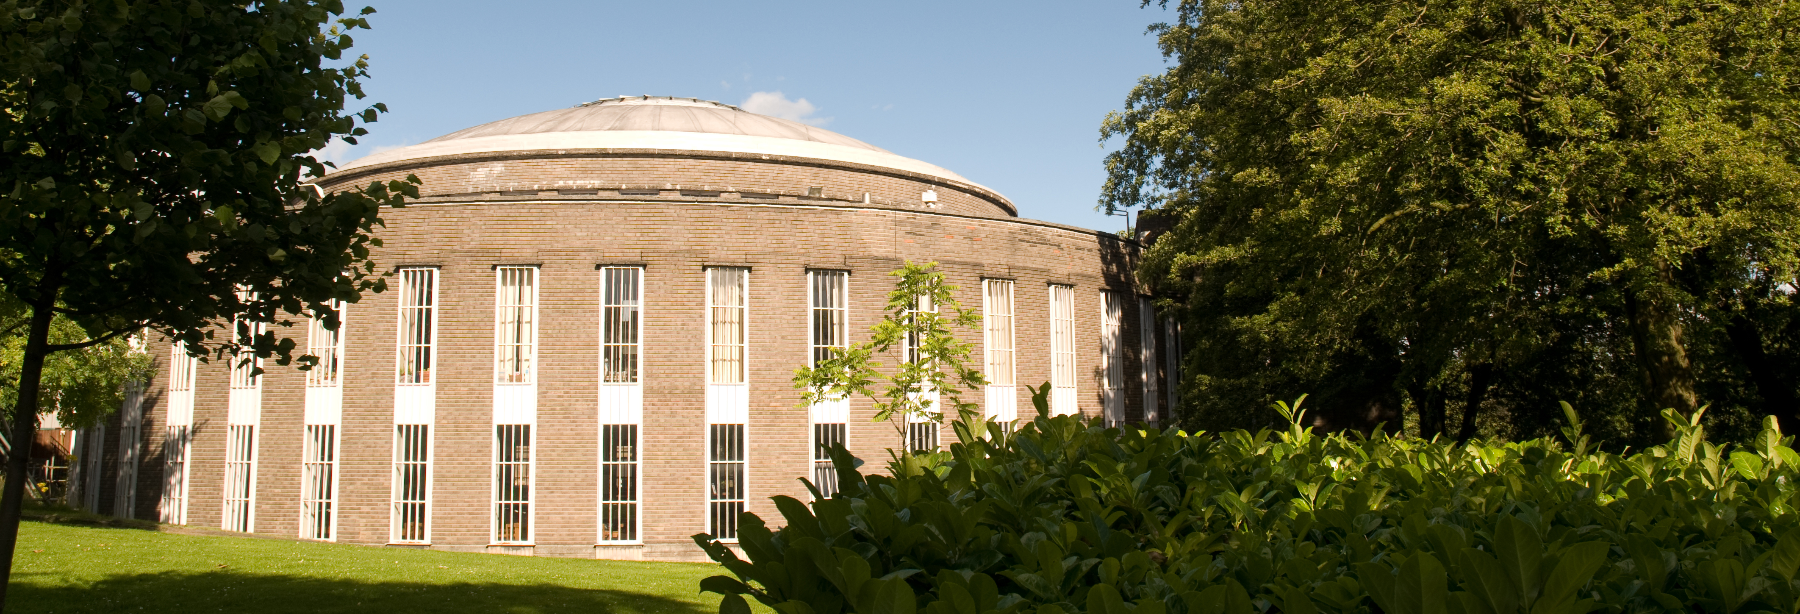
Contact details
SLD for Students
Student Learning Development
james.rowe@glasgow.ac.uk

